Slide 1

HACKATHON PROJECT

Slide 2
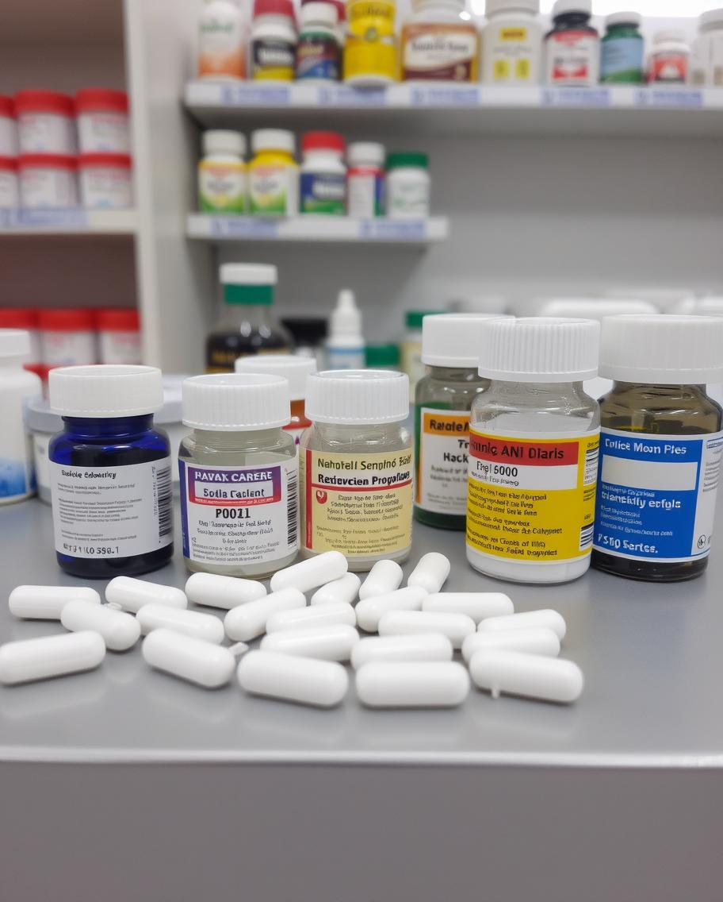
Problems faced due to Improper Dosage
DIABETES
Improper dosage of insulin or other glucose lowering medications leads to
complications like hypoglycemia which can be fatal if not managed properly.
Incorrect dosage of medications can result in increasing risk of heart
attack, stroke or kidney failure.
Incorrect dosage leads to poor Asthma and frequent emergency visits.
HYPERTENSION
ASTHMA

Slide 3

Key features of the app:
Connects doctors from various regions
App provides the first check up free of cost
Has a built in AI which helps doctors on the app decide the optimal dosage of medication
Provides them with a weekly report of their dosage
Provides reminders for, exercising, taking medications and regular doctor visits
Has an SOS button for any emergency on the device
A solution to all dosage related problems.

Slide 4

Additional Features
The emergency button feature can be accessed by gesture control like double tapping the back of the device, it enables an alert to an ambulance, nearest neighbors and close relatives of a person it also displays the first aid that can be given to the person as per the situation. This gesture can be personalized by individuals as per their liking
The AI provides dosage recommendation on the bases of your past record, current health conditions such as glucose levels, respiratory rate and blood pressure.
Helps them in adapting to a healthy lifestyle by various informative videos made by using AI.
The reports sent to the user tells the them their health stats and the dosage taken by them weekly.
The data provided to the app will be kept safe by encryption.

Slide 5




Marketing
For marketing of the app, various social media influencers would be approached for brand collaboration helping the app reach a wide range of audience targeting heavily on Gen – Z.
By collaborating with different companies having hardware related to measuring various health factors like respiratory rate, heart rate, blood pressure which helps the app by the data collected by them and in brand awareness and in return providing a solid software for the hardware of these companies.

Slide 6
TEAM
Amogh Anant
Arnav Sinha
Akshat Jain
Antaraj

Slide 7
THANK YOU

